Slide 1
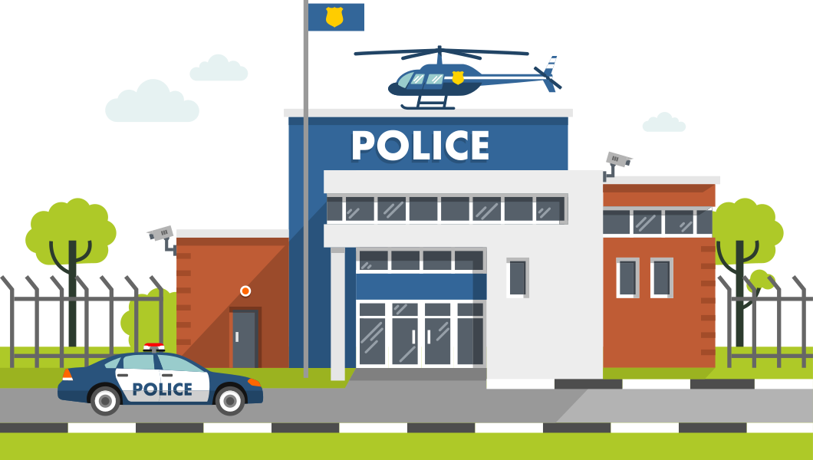


DISTRICT OF COLUMBIA CRIME REPORT
JANUARY - MARCH 2025
By Alfian Adi Pratama

Slide 2

Report Outline
01
Overview
Purpose of the report
Data sources and methodology
02
Crime Patterns in Early 2025
Most Common Crime Types and Methods
Time-Based Insights
03
Crime distribution and Hotspot
High-crime wards
Crime concentration by type and ward
04
Key Findings and Recomendation
Insight from data analysis
Strategic steps for crime prevention and public safety

Slide 3



Overview
Analyzing crime trends in Washington, D.C., to provide data-driven insights for policymakers and law enforcement
Purpose
Crime data obtained from the Metropolitan Police Department (MPD) of the District of Columbia.
Data Source
Data processing, trend analysis, and geospatial mapping to identify crime patterns and key findings.
Methodology

Slide 4
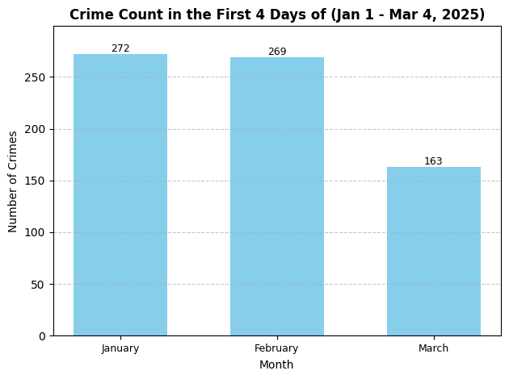
Crime Patterns in Early 2025
Crimes Overview (January – March 2025)
📌 Total Crimes occured: 4,005 cases
📌 Recorded period: Jan 1 – Mar 4, 2025
📌 Key insight:
January and February show full-month data, while March covers only 4 days.
First 4 days: Jan (272), Feb (269), Mar (163)
March shows a drop, but a full-month view is needed.

Slide 5
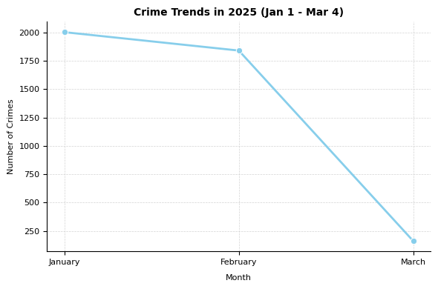
Crimes Trends (January 1 – March 4, 2025)
📌 Total cases occured: 4,005
📌 Highest: January (2,002 cases)
📌 Decline: February (1,840 cases)
📌 March (First 4 Days): 163 cases
March data is incomplete for full comparison.

Slide 6
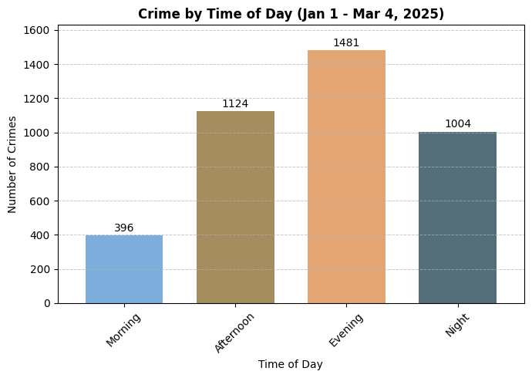
Crimes by Times of Day
📌 Most Crimes: Evening (1,481 cases)
📌 Afternoon: 1,124 cases
📌 Night: 1,004 cases
📌 Least Crimes: Morning (396 cases)

Slide 7
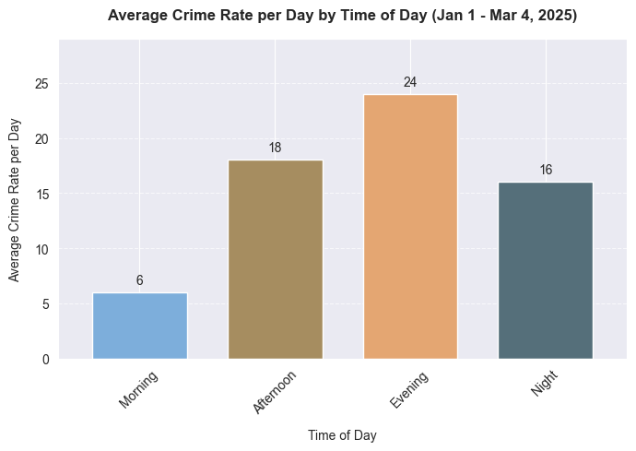
Crimes Rate by Times of Day
📌 Most Crimes: Evening (24/day)
📌 Afternoon: 18/day
📌 Night: 16/day
📌 Least Crimes: Morning (7/day)
Crime is high in the afternoon, evening, and night. Strategic patrols are needed during these hours.

Slide 8
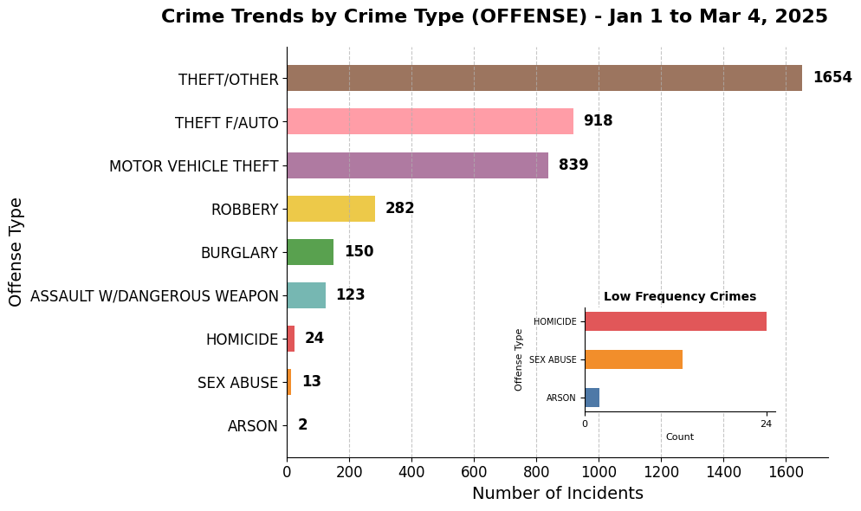
Crime Trends by Crime Type
📌 Most: Theft/Other (1,654)
📌 Auto: Theft f/Auto (918), Vehicle (839)
📌 Violent: Robbery (282), Assalut (123), Homicide (24)
📌 Rare: Arson (2), Sex Abuse (13)

Slide 9
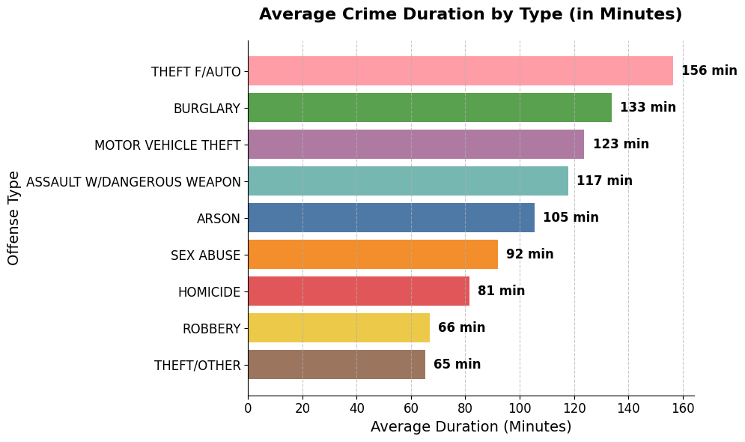
Crime Duration by Types
📌 Theft from Auto takes the longest (156 min).
📌 Burglary (133 min) & Vehicle Theft (123 min) also last long.
📌 Homicide (81 min) & Sex Abuse (92 min) take moderate time.
📌 Theft/Other is the quickest (65 min).

Slide 10
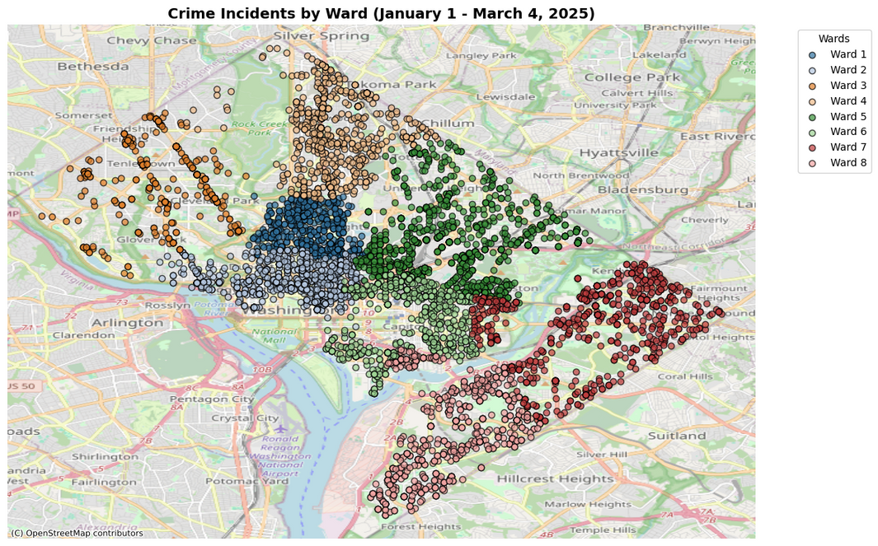
Crime Distribution and Hotspot
Geospatial Mapping
📌 Overview: Crime distribution across Columbia's wards in early 2025.
📌 Visualization: Each dot represents a crime incident, color-coded by ward.
📌 Purpose: Identifying hotspots for better law enforcement.

Slide 11
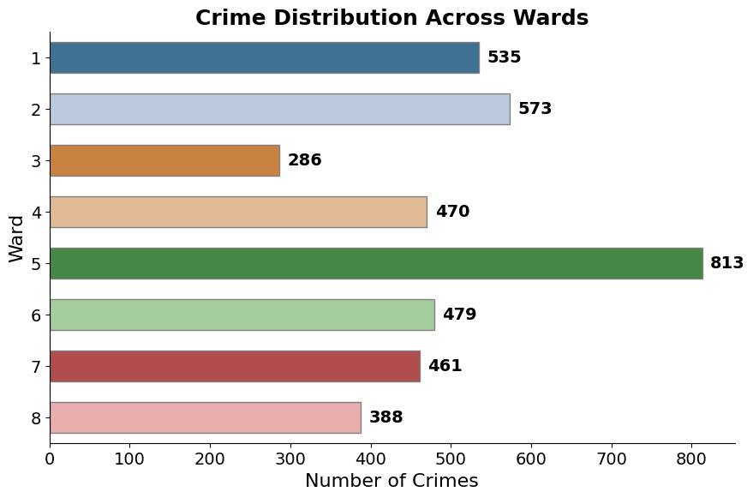
Crime Distribution by Ward and Types
📌 Ward 5 has the highest crime (813 cases)
📌 Ward 3 has the lowest crime (286 cases)
📌 Wards 1 & 2 also have significant crime (535 & 573 cases).
Ward 5 has the highest crime, Ward 3 the lowest, while Wards 1 & 2 also see notable crime levels, indicating concentrated risk areas.

Slide 12
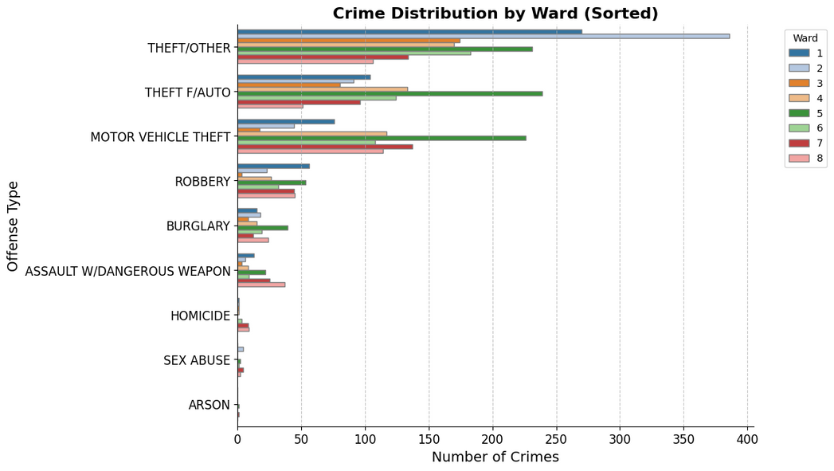
Crime Distribution by Ward and Types
📌 Theft/Other dominates WARD 1, 2, 3, 4, 6 (Peak: Ward 2 - 377 cases).
📌 Theft f/Auto leads in Ward 5 (236 cases).
📌 Motor Vehicle Theft is highest in Ward 7 & 8 (136 & 114 cases).
Note: Ward represents administrative districts in the city.

Slide 13
Key Findings and Recomendation
Insight from Data Analysis
Crime Peaks: Most crimes happen in the evening, mainly theft & vehicle theft.
High-Risk Areas: Ward 5 has the highest crime rate, with hotspots in poorly lit areas.
Crime Trends: Incidents are concentrated in specific locations, requiring targeted action.

Slide 14

Crime Prevention Strategies
Boost patrols in high-crime areas, especially at evening and night.
Install more CCTV & streetlights in dark hotspots.
Use data-driven policing to track and prevent crime.
Engage communities in safety programs & neighborhood watches.
Raise awareness on theft prevention & personal safety.

Slide 15
Thank You
Data source: Metropolitan Police Department (MPD)| Licensed under CC BY 4.0

